Slide 1
Data Structures II - Project Presentation I
Buffer Tree

Slide 2
cs201-s20-lightning-panthers
Group Members:
Muhammad Sabihul Hasan
Salman Muhammad Younus
Syed Hammad Ali
Agha Syed Nasir Mahmood Azeemi
Muhammad Faraz Ozair

Slide 3
Overview
Muhammad Sabihul Hasan

Slide 4
Limitation:
less than one I/O per operation
Approach:
save operations by buffering them
processing them in batches

Slide 5
Buffer Tree
Considering that the I/O model we chose had the following parameters:
N is the of elements in the problem instance
M is the of elements that can fit into main memory
B is the of elements per block
The data structure underlying the buffer tree is a balanced tree where every internal node has degree Θ(m).
Where m is equal to M/B (the number of blocks that fit into internal memory)

Slide 6
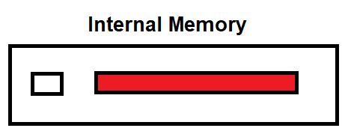
Internal Memory
There’s a block storing unprocessed operations which are collected until there a number of operations that can be processed in one batch.

Slide 7
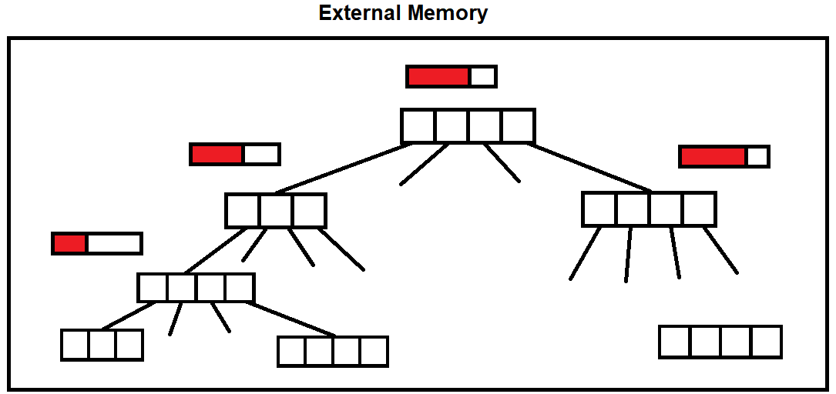
External Memory
We define internal nodes to be all nodes which do not have leaves as child.
Every internal node stores has a buffer, where it can store roughly M/B operations.

Slide 8
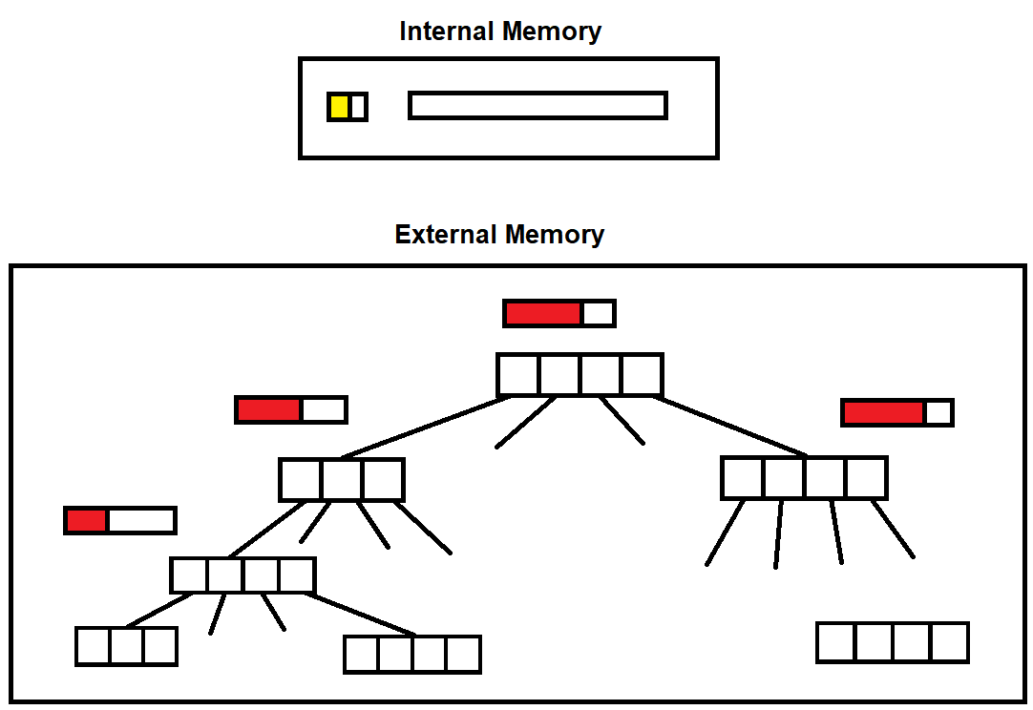

Slide 9
Processing Operations/ Updating the Tree
Salman Muhammad Younus
Syed Hammad Ali

Slide 10
Processing Operations
Consider the following operations on the tree:
insert(32)
insert(20)
search(32)

Slide 11



Each of these operations are loaded into the block present in the internal memory:
insert(32)
search(20)
search(32)

Slide 12
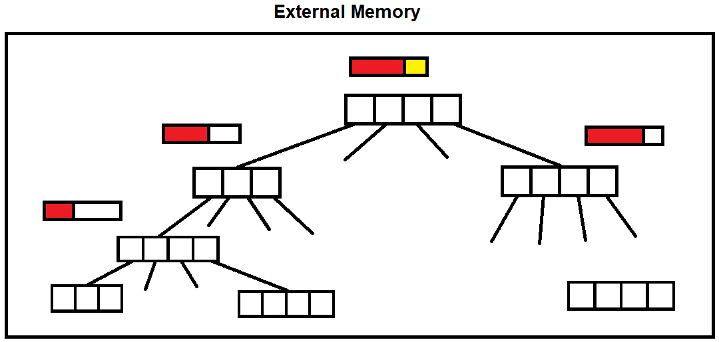
As the block in the internal memory is full, the block is loaded into the buffer present at the root node (only if it is not full)

Slide 13
What happens next?
If the buffer present at root node is full, it is flushed/emptied by getting placed into the internal memory.
If the buffer present at root node is not full, operations are loaded again into the internal memory block until it is full.

Slide 14
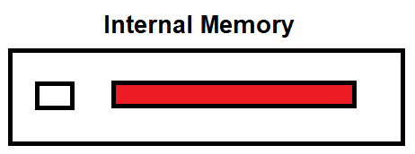
After the buffer is added into the internal memory, the operations present in it are first sorted according to their key.
For example:
insert(32) search(20)
search(20) insert(32)
search(32) search(32)
Why are the operations sorted?

Slide 15
The operations are further divided into the child buffers (according to the key value), who are then flushed/emptied in a similar way as the root buffer.

Slide 16
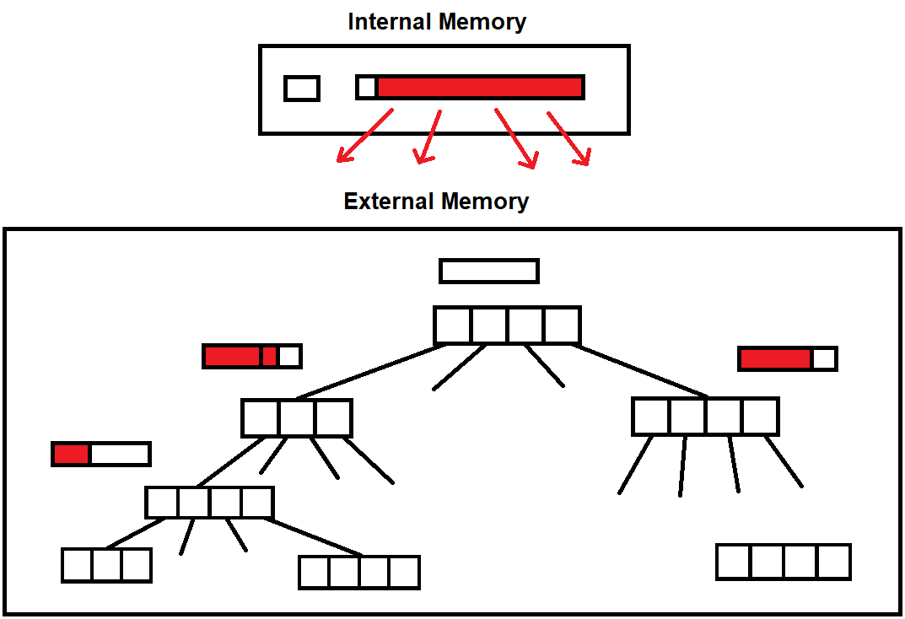

Slide 17
Note that as the buffer just above the leaves level are reached, then the buffer along with the elements of the leaf nodes are loaded into the internal memory.
Here the operations are finally carried out. (i.e. insert, search, delete etc.)

Slide 18
Applications
Agha syed nasir Mahmood azeemi
Muhammad faraz ozair

Slide 19
Sorting
The buffer tree could be used in sorting by first inserting any number of x items in the tree by using the insert algorithm described before.
The buffer’s empty/write operations take place. For this the buffer emptying process is started at the root of the buffer all the way down to the leaves.
The leaves are read sequentially from left to right to obtain the elements in sorted order. We can achieve a complexity of sorting in O(nlog(m)n) time (m being base of the size of buffer attached to each node).

Slide 20
Priority Queue
A buffer tree can be used for maintaining priority queue in the external memory by permitting update operation into the priority queue and adding an extra function that will delete the smallest element in the tree.
For extracting the smallest element, we first perform the buffer emptying process on all the nodes on the path from the leftmost leaf. By this we ensure that the leftmost leaf consists the A smallest elements and the children of the leftmost node consists of atleast Am/4 smallest elements, where m is the size of the buffer attached to each node.
This reduces our amortized cost since when deleting the minimum element, atleast Bm/4 delete minimum operations can be answered without doing additional I/Os. Therefore, the amortized cost is the same as sorting.

Slide 21
Mile Stones
Develop In-depth understanding of Data-Structure
Apr 16 - May 7
Select Application
May 7 - May 14
Identify Operations for Data-Structure
May 7 - May 14
Build Data-Structure
May 14 - Jun 23
Poster & Application Display
Jun 23 - Jul 9
Functions for Data-Structure are built
Jun 7, 2020
Integrate all Functions
Project Exhibition
Jun 14, 2020
Jul 2, 2020
2020
2017
Week 1
3
5
7
9
11
13
2020
Today
Apr 16, 2020
Jun 23, 2020
Project Presentation I
Project Presentation II

Slide 22
References
https://www.cs.dartmouth.edu/~ac/Teach/CS105-Winter05/
https://cs.au.dk/~gerth/emF03/slides/buffertrees.pdf
The Buffer Tree: A New Technique for Optimal I/O Algorithms by Lars Arge

